Slide 1
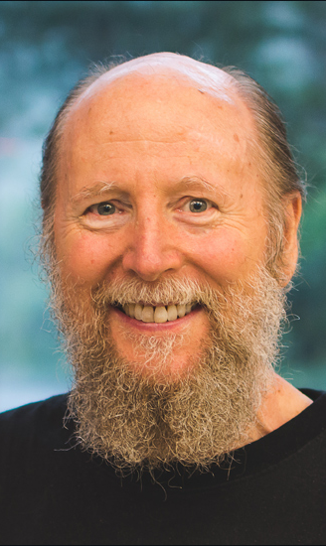
Leading RL Algorithms
Benny Bornfeld

Slide 2
The RL Mission characteristics
Number of states/actions (Q-Table/Function approximation)
Discrete/Continues states (e.g. game board/ motion)
Discrete/Continues actions. Some missions can be described in both (e.g. Lunar Lander engines)
Deterministic/Stochastic actions (Robot welding/Poker)
Reward Sparsity (Chess/Racing game)
Model Free/Model Based
Model based – The environment expressed by F(S’, R|S,A)
A priory
Learned during training

Slide 3
Desired Solution Characteristics
Optimal Solution
Generalization
Stability
Low sensitivity to hyper-parameters
Complexity
Sample Efficiency

Slide 4
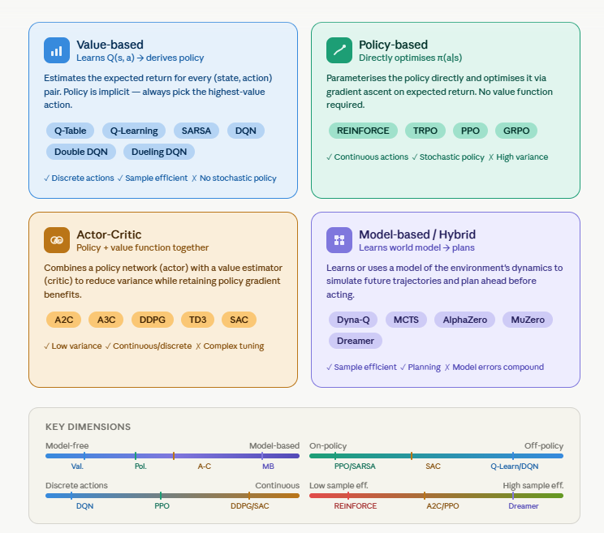
Families of RL Algorithms

Slide 5
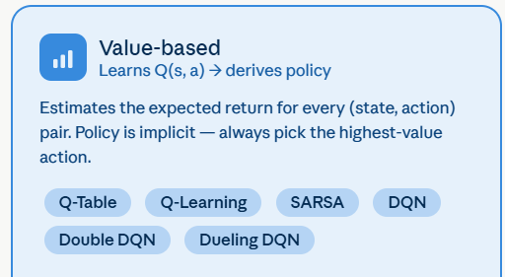
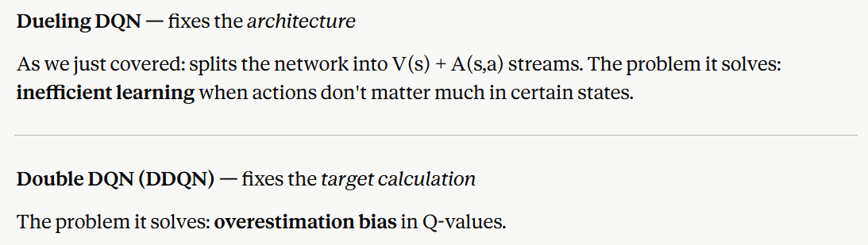
Value Based

Slide 6
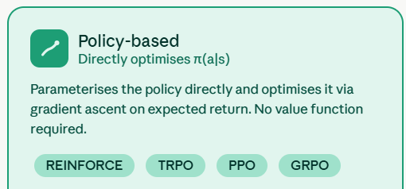
Policy Based

Slide 7
Policy Gradient Methods

Slide 8
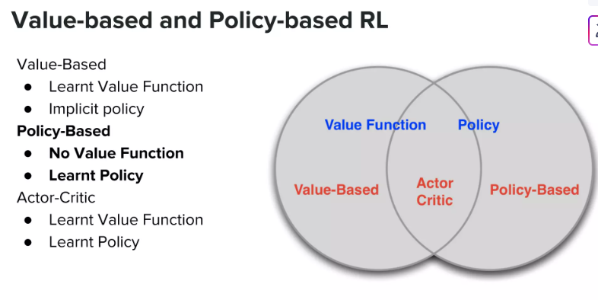

Slide 9
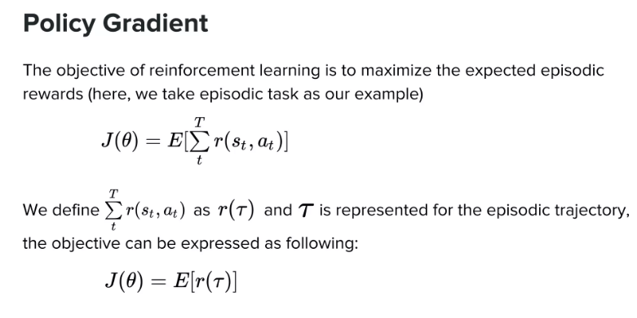

Slide 10
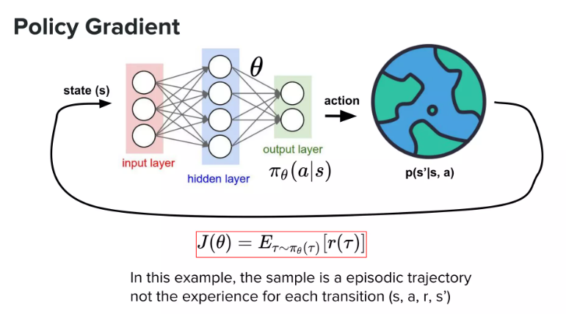

Slide 11
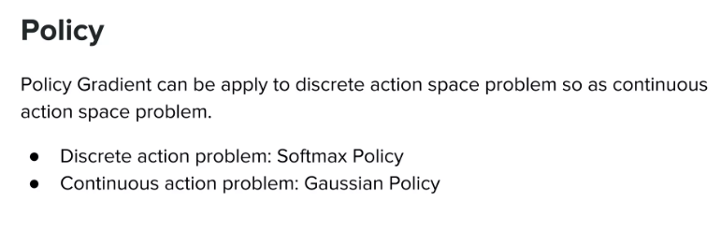

Slide 12
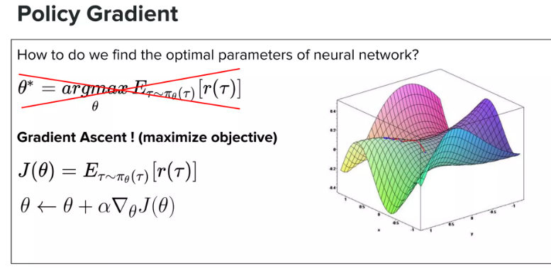
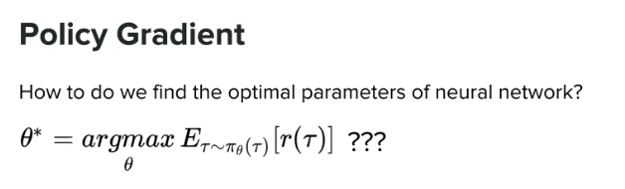

Slide 13
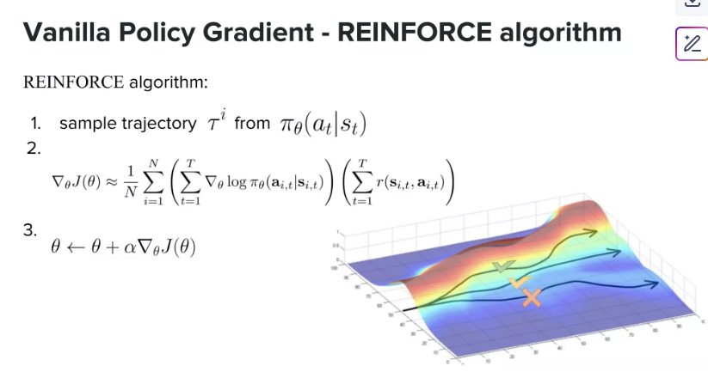
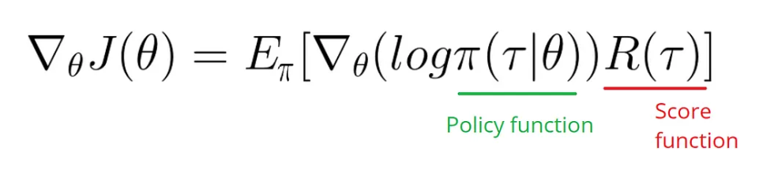

Slide 14
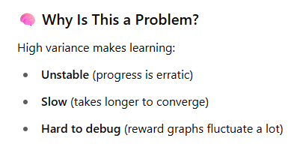
Limitations of the Basic Policy Gradient algorithm

Slide 15
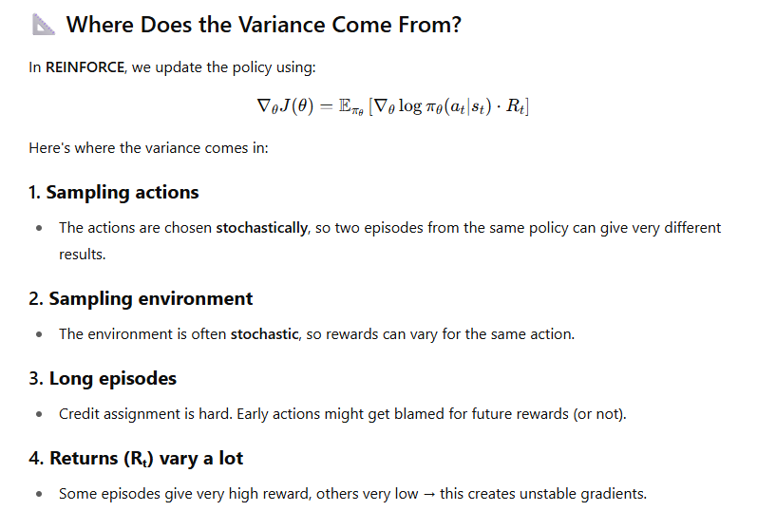
Limitations of the Basic Policy Gradient algorithm

Slide 16
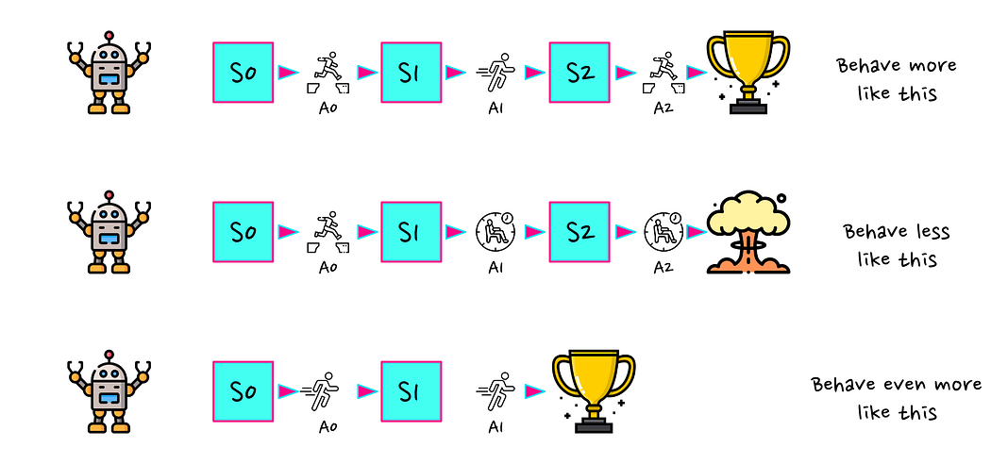
Credit assignment

Slide 17
Variance Reduction
Causality
Baseline
Advantage functions

Slide 18
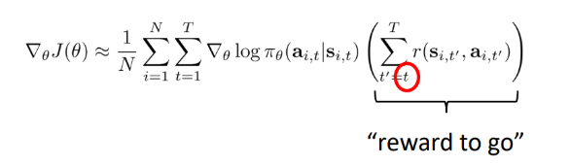
Causality
An action has an effect only on future returns.

Slide 19
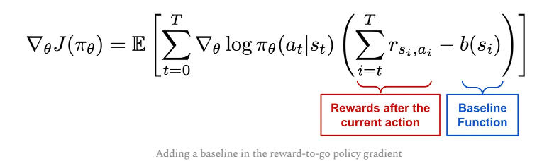
Baseline
Compare the reward to a baseline reward, usually the average

Slide 20
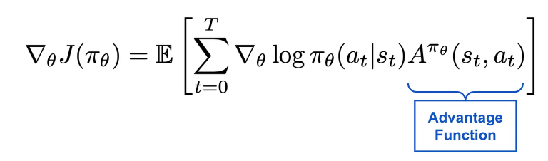
Advantage function
Learn the advantage of taking a specific action

Slide 21
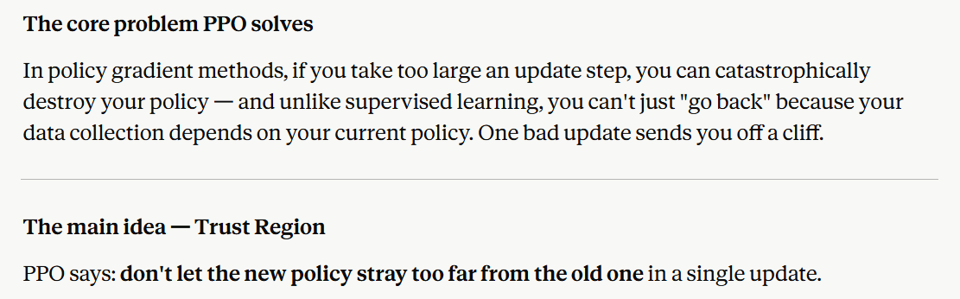
PPO - Proximal policy optimization

Slide 22
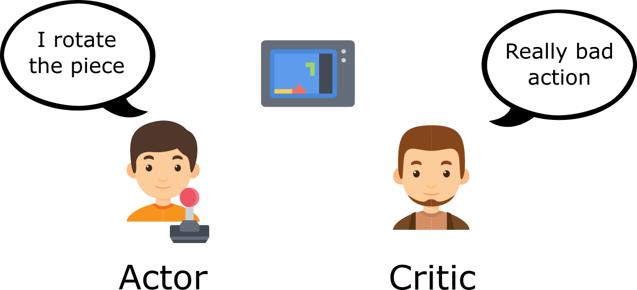
Actor - Critic

Slide 23
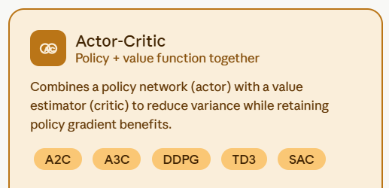
Actor Critic

Slide 24
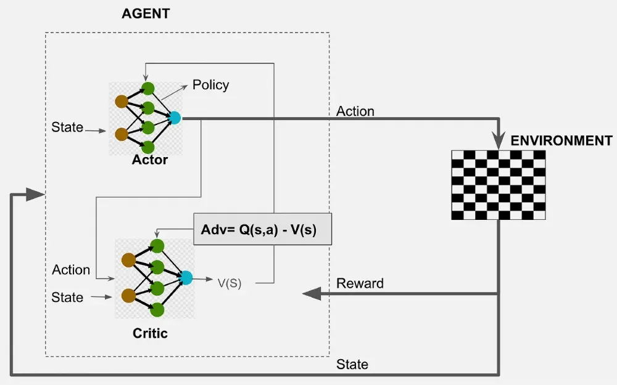
Actor - Critic

